Slide 1
Climate Change Visualization
Katlin Bowman, Jacob Trevithick, William Lubenow, Michael Bradberry

Slide 2
Summary
We looked at data from various countries detailing greenhouse gas emissions as well as power plant information.
Data includes:
Types of emissions per country per year.
Individual power plant’s location and fuel type.
Total emissions per year.
Total amount of power (gwh) generated per year.
Data sources:
Global Energy Observatory, Google, KTH Royal Institute of Technology in Stockholm, Enipedia, World Resources Institute. 2018. Global Power Plant Database. Published on Resource Watch and Google Earth Engine; http://resourcewatch.org/ https://earthengine.google.com/
United Nations. 23 March 2017. International Greenhouse Gas Emissions: A global GHG inventory from 1990-2017. https://www.kaggle.com/unitednations/international-greenhouse-gas-emissions

Slide 3

Data Visualization Goals
Global map showing the location of “clean” and “dirty” power plants
Shaded overlay of total greenhouse gas emissions for each country
Dropdown menu to display data by country
Charts:
Proportion and time trend for clean v. dirty energy production
Time trend for energy related greenhouse gas emissions
Most common types of power plants
New JavaScript Library: Chart.js (radar plot)

Slide 4
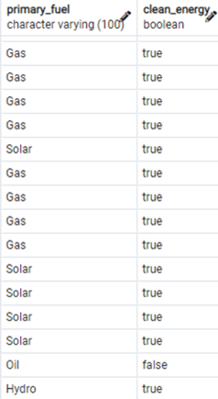
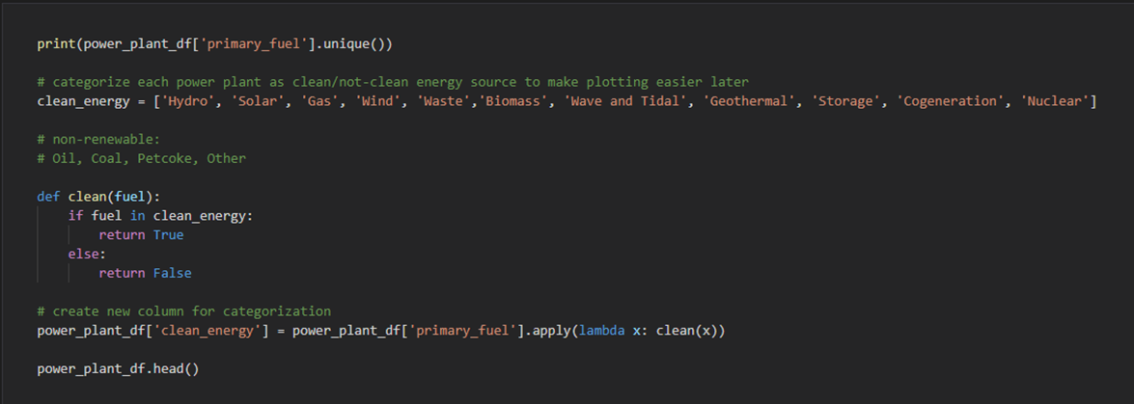
Data Cleaning
Normalized country names in both datasets (first letter -> lowercase, stripped any outside characters) for future merge
clean_energy column used for map & charts

Slide 5
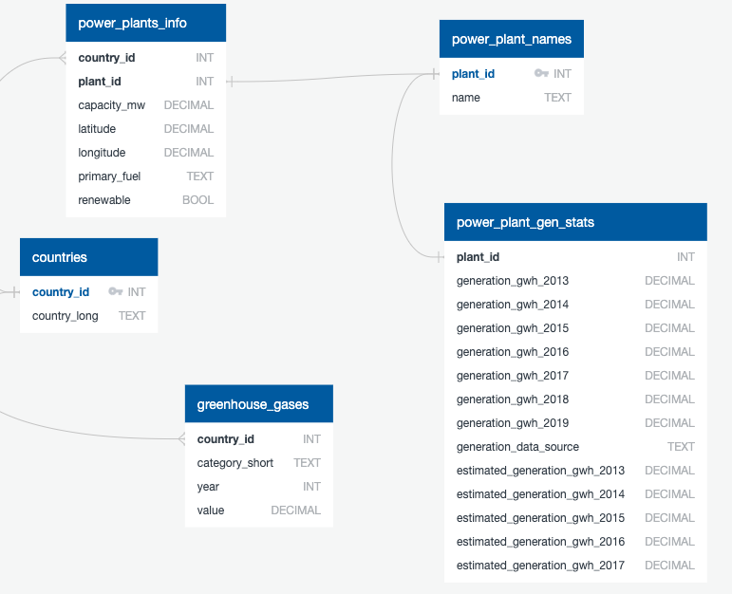
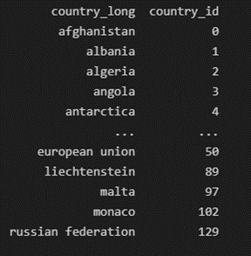
Data Cleaning
Created country ID numbers for database management
Appended greenhouse gas dataframe to power plant dataframe
Grouped by country name, then used ngroup() function to assign each group a number
Created a new dataframe with country names and id numbers for merging
Merged & sliced data for export into 5 SQL tables

Slide 6
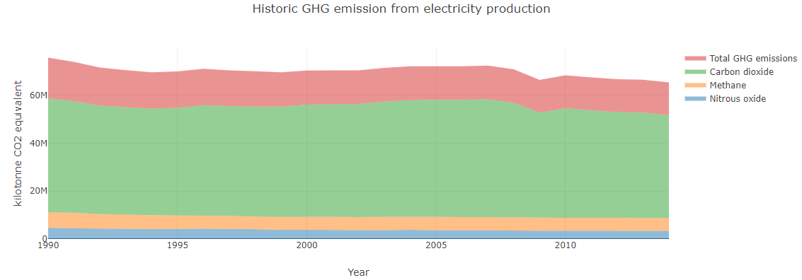
Global Emissions
A stacked line graph was created to show the amounts of different greenhouse gases as well as total emissions.
Overall, emissions have declined since 1990 with the largest decrease happening in 2009. Slight increase in the early 2000’s.

Slide 7
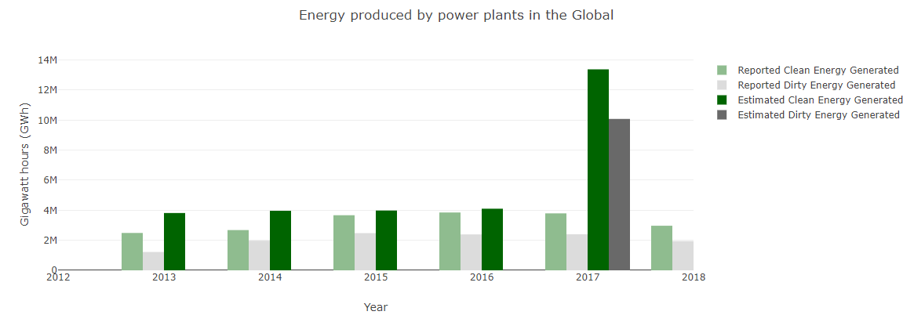
Global Power Plants
In both reported and estimated amounts, clean energy saw higher amounts of generated power.
86.5% of global power plants use clean energy.
Solar, hydro, and wind are the most common.

Slide 8
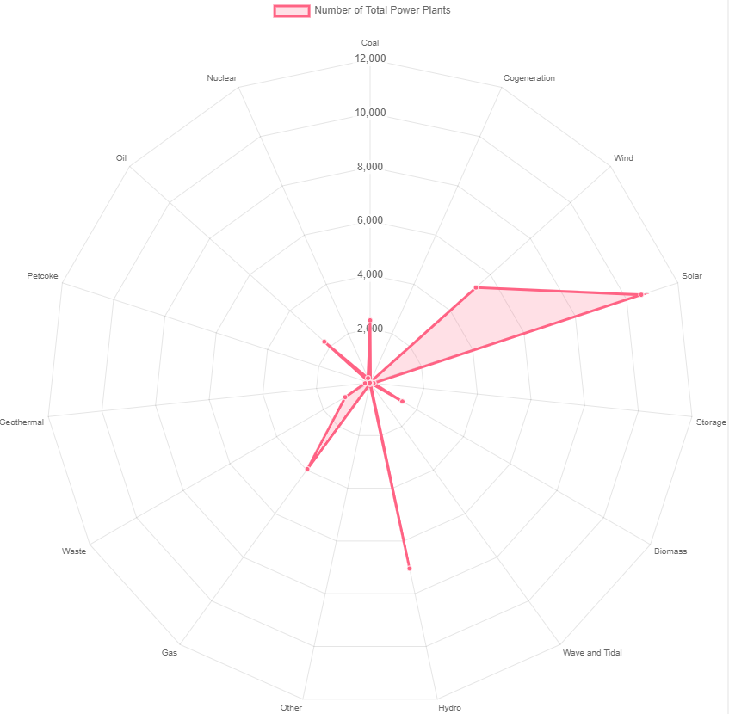
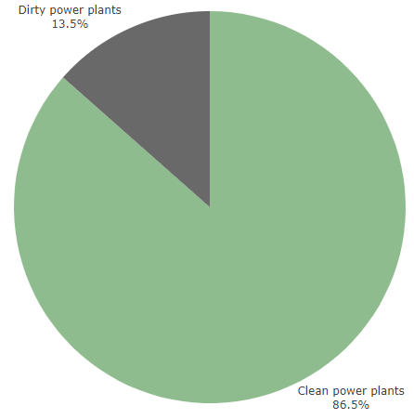
Global Power Plants

Slide 9
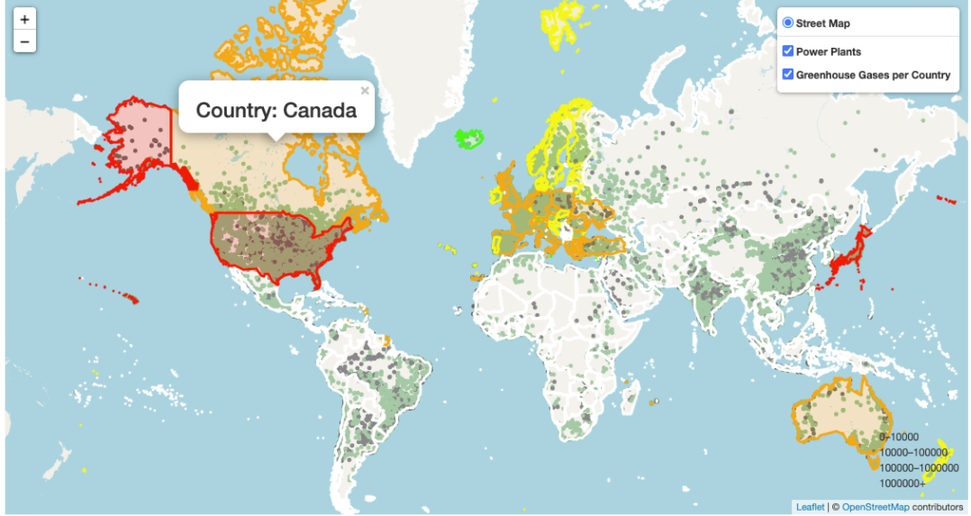
Global Power Plants
Global map showing the locations of all power plants.
Pop ups show additional information.
Green for clean energy, dark grey for dirty energy.
Countries are outlined.

Slide 10
Flask App
home route : render html template
index.html → logic.js
logic file generates flask global view url
global view route: triggers function to pull global data (greenhouse gas sums, clean v. dirty energy, etc.)
All charts populate with global data
When country selected from drop-down menu, triggered function in logic.js creates a flask country name url
country name route: triggers function to pull data for selected country (greenhouse gas sums, clean v. dirty energy, etc.)

Slide 11
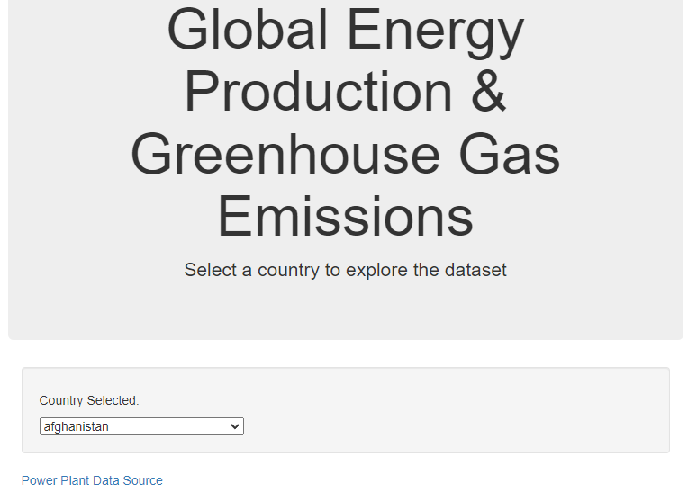
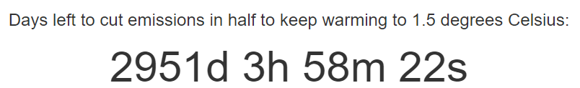
Flask App
Initial graphs are loaded with global data.
Use the dropdown menu to view data on a specific country.
Pop Ups will show on graphs if the user moves their cursor over them.
Links with the data sources are included.
Doomsday countdown included at the bottom.

Slide 12
Lessons Learned
Flask app is slow to update JavaScript file edits.
Unlike Plotly, the radar chart from Chart.js must be destroyed and recreated when a different country is selected.
Most countries are lowering emissions through clean energy.
Very limited amount of time to control emissions before there is no turning back.

Slide 13
Questions

Slide 14
THANKS
Do you have any questions?
youremail@freepik.com
+91 620 421 838
yourcompany.com
Please keep this slide for attribution

Slide 15
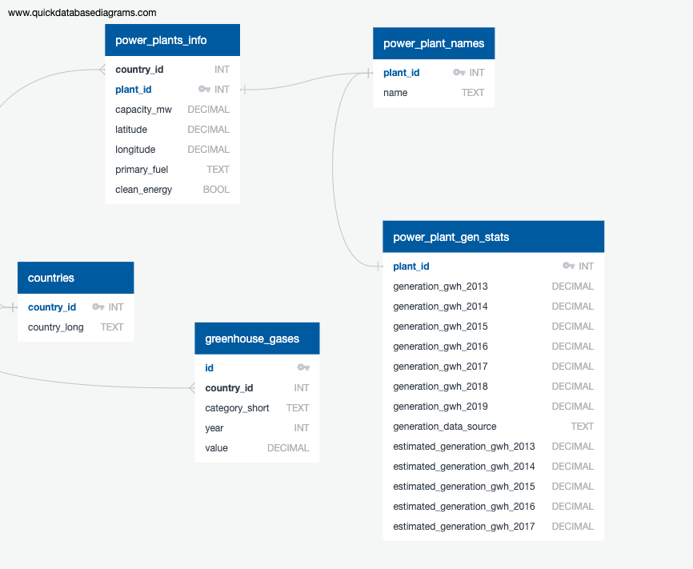
ETL Pipeline
Data downloaded as csv files and imported into Pandas for cleaning.
Data was broken down into smaller tables for ease of use.
The cleaned data was put into a SQL database and an ERD was created.
SQLAlchemy is used to call data for further analysis.
D3, Plotly, Leaflet, and Chart.js were used for visualizations.

Slide 16
Data Cleaning
Removed unwanted columns and checked for missing values.
In the power plant database, dropped duplicate rows by power plant name.
In the greenhouse gas database, values were shortened.
'carbon_dioxide_co2_emissions_without_land_use_land_use_change_and_forestry_lulucf_in_kilotonne_co2_equivalent': 'co2',
Normalized country names in both datasets (first letter -> lowercase, stripped any outside characters) for future merge.
power_plant_df['country_long'] = power_plant_df['country_long'].apply(lambda x: x.lower().strip())

Slide 17
Data Cleaning
Created country ID numbers for database management
Appended greenhouse gas dataframe to power plant dataframe
combined_df_no_id = power_plant_df.append(greenhouse_df, sort=False, ignore_index=True)
Grouped by country name, then used ngroup() function to assign each group a number
combined_df_no_id['country_id'] = combined_df_no_id.groupby(['country_long']).ngroup()
Created a new dataframe with country names and id numbers, dropped duplicate countries
id_slice_df = combined_df_no_id[['country_long', 'country_id']].drop_duplicates(keep='first')
Left merged this new dataframe into power plant and greenhouse gas dataframes on country name
power_plant_id_df = power_plant_df.merge(id_slice_df, on = 'country_long', how='left')

Slide 18
Data Cleaning
More slicing and merging of dataframes for export into 5 different SQl tables

